Slide 1
Responsive Design
& Mobile First Layout
2nd ristek is sharing session

Slide 2

Responsive Design
A (web) design that responds to the viewing environment.

Slide 3
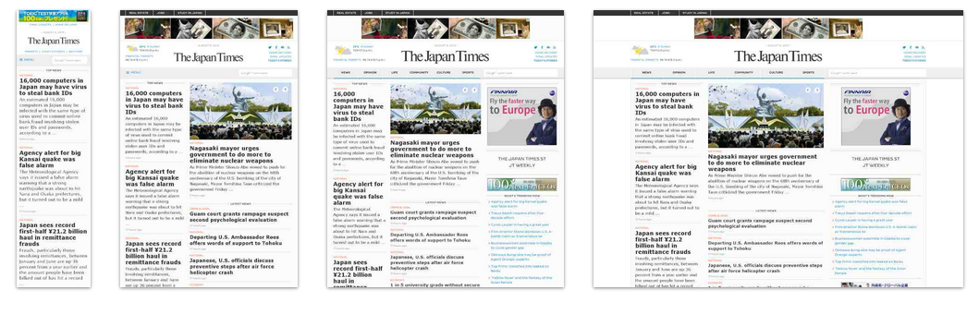
The Japan Times

Slide 4
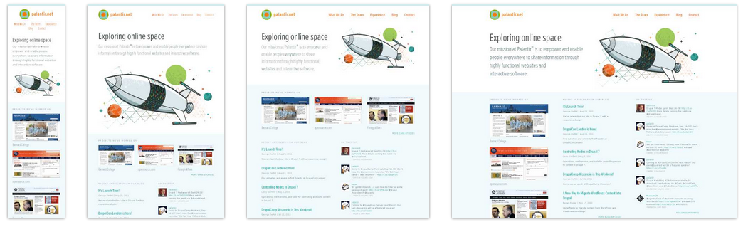
Palantir

Slide 5
Why Do Responsive Design?
Rise of mobile phones popularity
People are browsing on mobile phones more often than on PC
Lots of different screen sizes
We must provide the best experience for all users

Slide 6


Slide 7
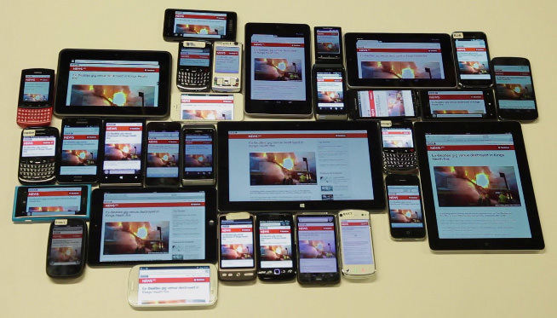

Slide 8
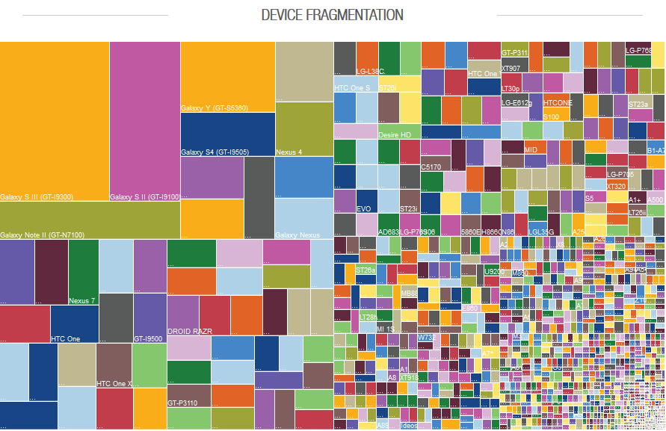

Slide 9
Those are a Lot of Screen Sizes
We must serve the most suitable experience to ALL users.

Slide 10
Elements of Responsive Design
Fluid Layout
Flexible Images
Media Queries

Slide 11
Fluid Layout
All size units are set in percentage / or em
No fixed/pixel based size, use max-width
Flexible margin and padding
body { width: 1000px; } → body { max-width: 1000px; }
.sidebar { width: 400px; } -> .sidebar { width: 25%; }

Slide 12
Flexible Images
No fixed width images
Instead of
img { width: 200px; }
Use
img { max-width: 100%; }
Set maximum width to 100% of container width;

Slide 13
Media Queries
@media (max-width: 960px) {
// desired css
}
That means if the current viewport width <= 960px, load the desired css
Usually called ‘breakpoint’

Slide 14
Popular Width Breakpoints
<= 320px [Very small phones]
<= 480px [Small smartphones]
<= 720px [Today’s smartphone standard]
<= 1024px [iPad, Tablets, & old desktops]
<= 1224px [Laptops & desktops]
<= 1824px [Large screen]
>1824 [Very large screen]

Slide 15
Media Query Usage
.container
.container
.container
.container
On Desktop
On Mobile

Slide 16
Media Query Usage
.container {
width: 50%;
}
@media (max-width: 720px) {
.container {
width: 100%;
}
}

Slide 17
Hide an Element when on Mobile?
Done.
.sidebar {
display: block;
}
@media (max-width: 720px) {
.sidebar {
display: none;
}
}

Slide 18
Other Media Query Properties
width - monochrome
height - resolution
device-width - scan
device-height - grid
orientation
aspect-ratio
device-aspect-ratio
color
color-index

Slide 19
Tips for working on real device
<meta name= “viewport” content= “initial-scale=1.0, width=device-width” />
Use this <meta> tag to set the browser’s initial scale to 1.
Further information
http://css-tricks.com/snippets/html/responsive-meta-tag/

Slide 20
Development Workflow
Mobile First, then enhance as the screen got bigger.
Desktop First, then reduce as the screen got smaller.
For today’s website, responsive design is a MUST.

Slide 21
Know Further
http://alistapart.com/article/responsive-web-design (The original article by Ethan Marcotte)
Responsive Web Design [Ethan Marcotte, 2011]
Mobile First [Luke Wroblewski, 2011]
http://mediaqueri.es/ (Responsive Design Showcase)
http://learn.shayhowe.com/advanced-html-css/responsive-web-design/ (Great in-depth tutorial on responsive design)

Slide 22
Practice & Challenge
You have been tasked to make a news website responsive. Design the best layout and experience for mobile phones, tablets, and laptops.
Download the original unresponsive site:
http://goo.gl/tdVYPb (Zip)
http://www.filedropper.com/2responsive (Zip Mirror)
Sample responsive solution
http://goo.gl/VHsisE (Zip)
http://www.filedropper.com/2responsivesolution (Zip Mirror)

Slide 23
Good luck! :D
Minggu depan dateng yaa :D

